Slide 1
Chapter 02
Knowledge Management Processes

Slide 2
Objectives
Major Approaches to the KM Cycle
Strategic Implications of the KM Cycle
Practical Considerations for Managing Knowledge

Slide 3
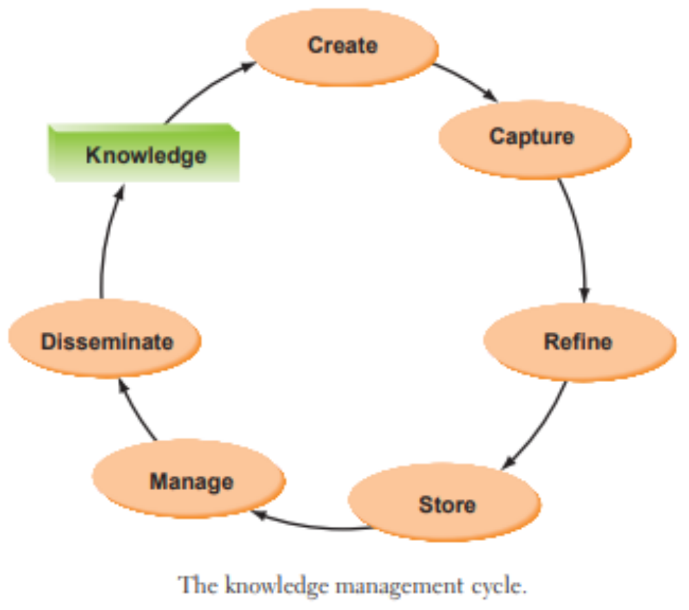
Major Approaches to the KM Cycle
The KM cycle focuses on processes to identity knowledge content that is of value to the organization and its employees

Slide 4
Major Approaches to the KM Cycle
The following models highlight the major phases included in the cycle:
  The Meyer and Zack KM Cycle (1996)
  The Bukowitz and Williams KM Cycle (2000)
  The McElroy KM Cycle (1999)
  The Wiig KM Cycle (1993)
  The Carlile and Rebentisch Knowledge Transformation Cycle (2003)
  The Evans, Dalkir, and Bidian KM Cycle (2015)

Slide 5
Major Approaches to the KM Cycle
  The Meyer and Zack KM Cycle (1996)
  The Bukowitz and Williams KM Cycle (2000)
  The McElroy KM Cycle (1999)
  The Wiig KM Cycle (1993)
  The Carlile and Rebentisch Knowledge Transformation Cycle (2003)
  The Evans, Dalkir, and Bidian KM Cycle (2015)

Slide 6
The Meyer and Zack KM Cycle
  Research and knowledge about the design of physical products can be extended into the intellectual realm to serve as the basis for a KM cycle.
  Platforms:
    Product platform: the knowledge repository
    Information process platform: the knowledge refinery
  Information Unit: formally defined atom of information to be stored, retrieved, and manipulated

Slide 7
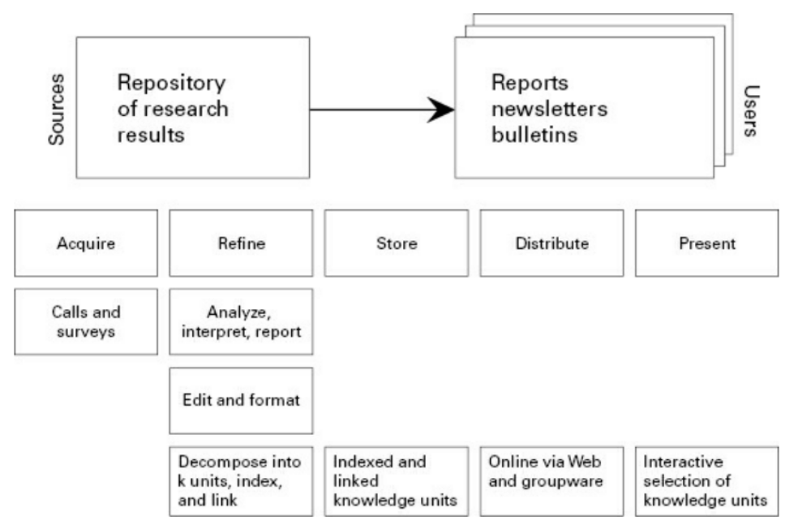
The Meyer and Zack KM Cycle

Slide 8
The Meyer and Zack KM Cycle
Acquisition:
  Issues of raw materials: scope, breadth, depth, credibility, accuracy, timelines, relevance, cost, control and exclusivity
  “garbage in garbage out”: data has to be in highest quality.
Refinement:
  Primary source of added value
  Physical refinement: moving between mediums
  Logical refinement: restructuring, (re)labelling, indexing and integrating, cleaning up / sanitizing content

Slide 9
The Meyer and Zack KM Cycle
Storage and Retrieval
  Bridge from acquisition and refinement to product generation
  Physical: folder, printed information
  Digital: database, knowledge management software
Distribution
  How information is delivered to end users: fax, print, email. Publication on a web page
  Timing, frequency, form, language,
  …
  Presentation
    Context plays important role
    Users have to have enough context to be able to make use of a content

Slide 10
Major Approaches to the KM Cycle
  The Meyer and Zack KM Cycle (1996)
  The Bukowitz and Williams KM Cycle (2000)
  The McElroy KM Cycle (1999)
  The Wiig KM Cycle (1993)
  The Carlile and Rebentisch Knowledge Transformation Cycle (2003)
  The Evans, Dalkir, and Bidian KM Cycle (2015)

Slide 11
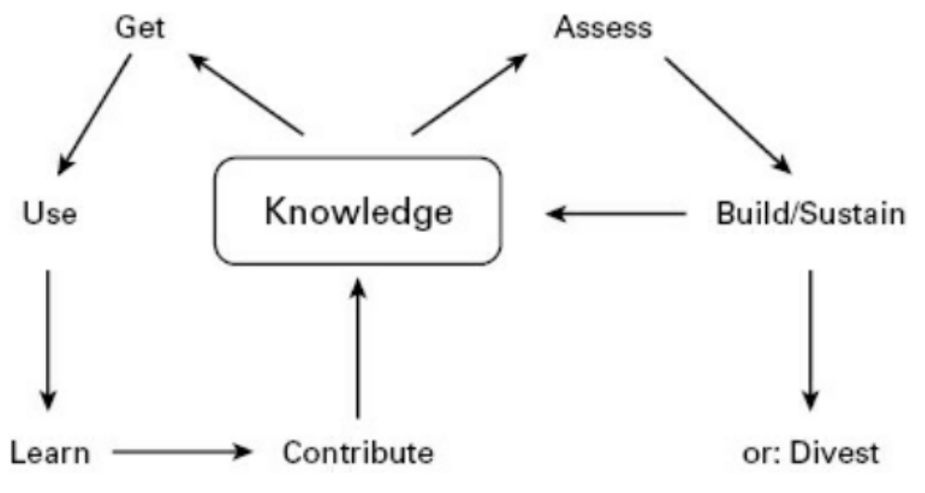
The Bukowitz and Williams KM Cycle
Bukowitz and Williams describe a KM process framework that outlines “how organizations generate, maintain, and deploy a strategically correct stock of knowledge to create value.”

Slide 12
The Bukowitz and Williams KM Cycle
Get:
  Seek out needed information:
    For decision making, problem solving or innovation
  Think of information overload
  User need must be well understood
  Know where knowledge resources exist
Use:
  How to combine information
    In new and interesting ways to foster organization innovation
  Focus on individuals and then on groups

Slide 13
The Bukowitz and Williams KM Cycle
Learn:
  Learning from experiences
    Means of creating competitive advantage
  Creation of organizational memory
    Best practices and lessons learned
  Transition between application and generation
Contribute:
  Getting employees to post
    What the have learned
  Making knowledge visible and available
  Sharing

Slide 14
The Bukowitz and Williams KM Cycle
Assess:
  Evaluation of intellectual capital
  Definition of mission-critical knowledge
  Map of current intellectual capital
    Against future knowledge needs
  Requirements for new set of processes
Build / sustain
  Allocation of resources:
    To growth and maintenance of knowledge
  Creation of new knowledge
  Reinforcement of existing knowledge

Slide 15
The Bukowitz and Williams KM Cycle
Divest
  Identification of obsolete knowledge
    Knowledge that gives no value any further
  Examination of resources required
    To maintain knowledge
  Redeploying, outsourcing or terminating

Slide 16
Major Approaches to the KM Cycle
  The Meyer and Zack KM Cycle (1996)
  The Bukowitz and Williams KM Cycle (2000)
  The McElroy KM Cycle (1999)
  The Wiig KM Cycle (1993)
  The Carlile and Rebentisch Knowledge Transformation Cycle (2003)
  The Evans, Dalkir, and Bidian KM Cycle (2015)

Slide 17
The McElroy KM Cycle
McElroy (1999) describes a knowledge life cycle that consists of the knowledge processes of knowledge production and knowledge integration, with a series of feedback loops to organizational memory, beliefs, claims and the business-processing environment.

Slide 18
The McElroy KM Cycle
Knowledge is held
  Subjectively in minds of individuals and groups
  Objectively in explicit forms
Knowledge use in business-processing environment
  Matched expectations: reinforcement of existing knowledge, lead to reuse, double-loop learning
  Failed to match expectations: adjustments in business processing behavior, single-loop learning

Slide 19
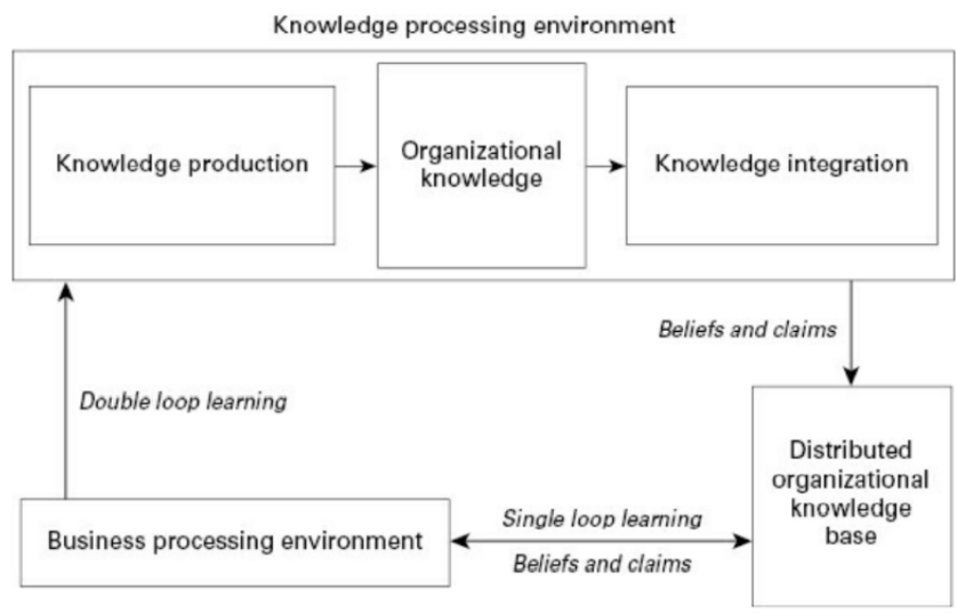
The McElroy KM Cycle

Slide 20
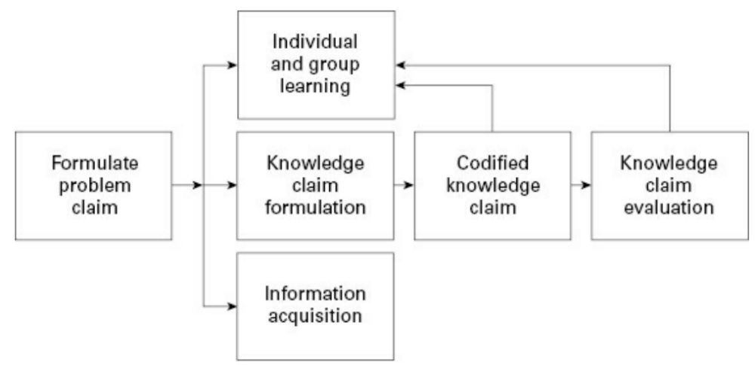
The McElroy KM Cycle

Slide 21
The McElroy KM Cycle
Knowledge integration
  Introduction of new knowledge claims to organization’s operating environment
  Retirement of old knowledge claims
Validation of knowledge is a step that clearly distinguished knowledge management from document management

Slide 22
Major Approaches to the KM Cycle
  The Meyer and Zack KM Cycle (1996)
  The Bukowitz and Williams KM Cycle (2000)
  The McElroy KM Cycle (1999)
  The Wiig KM Cycle (1993)
  The Carlile and Rebentisch Knowledge Transformation Cycle (2003)
  The Evans, Dalkir, and Bidian KM Cycle (2015)

Slide 23
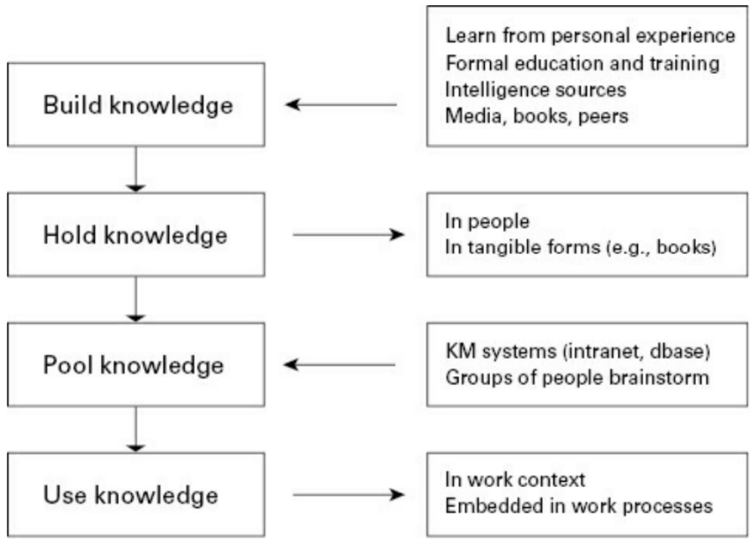

The Wiig KM Cycle

Slide 24
The Wiig KM Cycle
Wiig conditions: Organization must have
  Business and customers: products and services
  Resources: people, capital and facilities
  Ability to act
Knowledge is the principal force that determines and drives the ability to act intelligently

Slide 25
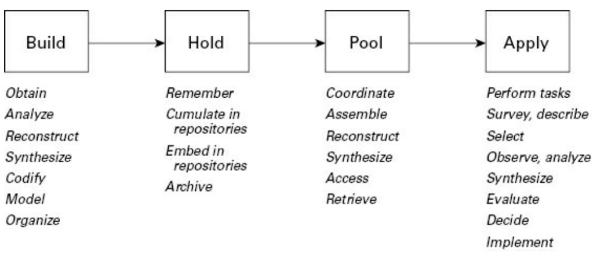
The Wiig KM Cycle

Slide 26
The Wiig KM Cycle
Building knowledge consists of five major activities:
    1.Obtain knowledge
    2.Analyze knowledge
    3.Reconstruct/synthesize knowledge
    4.Codify and model knowledge
    5.Organize knowledge

Slide 27
The Wiig KM Cycle
Obtaining knowledge
  Research and development projects
  Innovations by individuals
  Experimentation
  Reasoning with existing knowledge
  Hiring new people

Slide 28
The Wiig KM Cycle
Knowledge analysis
  Extracting – from obtained material (transcripts, identify themes)
  Abstracting – from model or a theory
  Identifying patterns – trend analysis
  Explaining relations between knowledge fragments
  Verifying – that meaning has not been corrupted through summarizing

Slide 29
The Wiig KM Cycle
Synthesis or reconstruction
  Generalization of analyzed material
    To obtain broader principles
    Generating hypotheses
  Establish conformance
    Between new and existing knowledge
  Update knowledge pool
    Incorporate new knowledge

Slide 30
The Wiig KM Cycle
Codifying and Modeling
  Accord with mental models
    Knowledge should be codified in the way that it would be understandable by employees and will fit employees way of thinking, doing things and interpreting things
  How knowledge is assembled
  How knowledge is documented

Slide 31
The Wiig KM Cycle
Organization of knowledge for specific uses and according to an established organizational framework
Holding
  Remembering: knowledge has been internalized or understood
  Accumulating: knowledge has been enclosed and stored in a knowledge base
  Embedding: knowledge becomes part of procedure manual
  Archiving: creating a library, systematically retiring out-of-date or not relevant knowledge

Slide 32
The Wiig KM Cycle
Pooling
  Coordination of knowledge
    Formation of collaborative teams
    “who knows what” network
  Assembly
    Into background references
  Access and retrieval
    Be able to consult with knowledgeable people or knowledge base
Application:
  The myriad ways in which knowledge can be applied and used are linked to decision-making sequences and individual characteristics

Slide 33
Major Approaches to the KM Cycle
  The Meyer and Zack KM Cycle (1996)
  The Bukowitz and Williams KM Cycle (2000)
  The McElroy KM Cycle (1999)
  The Wiig KM Cycle (1993)
  The Carlile and Rebentisch Knowledge Transformation Cycle
  The Evans, Dalkir, and Bidian KM Cycle (2015)

Slide 34
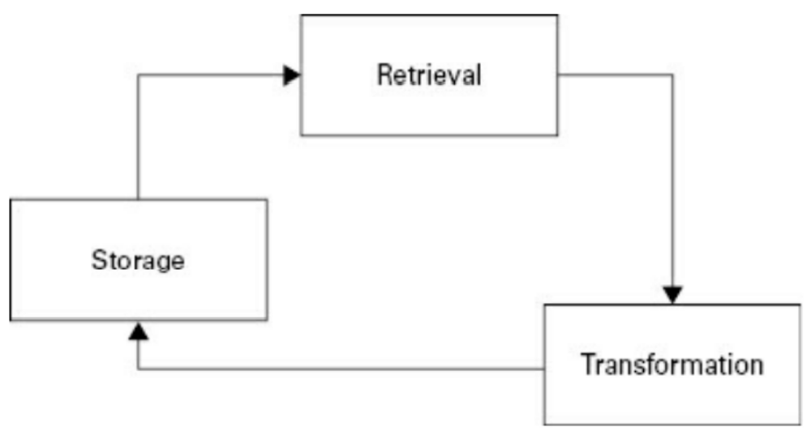
The Carlile and Rebentisch Knowledge Transformation Cycle

Slide 35
The Carlile and Rebentisch Knowledge Transformation Cycle
Storage: adding new knowledge to existing knowledge
Retrieval: from not only the storage but also from tacit knowledge from people.
Transformation: the most reuse of knowledge does not consist of “as is” reuse: knowledge tends to be changed, at least updated, before it is reused.

Slide 36
Major Approaches to the KM Cycle
  The Meyer and Zack KM Cycle (1996)
  The Bukowitz and Williams KM Cycle (2000)
  The McElroy KM Cycle (1999)
  The Wiig KM Cycle (1993)
  The Carlile and Rebentisch Knowledge Transformation Cycle (2003)
  The Evans, Dalkir, and Bidian KM Cycle (2015)

Slide 37
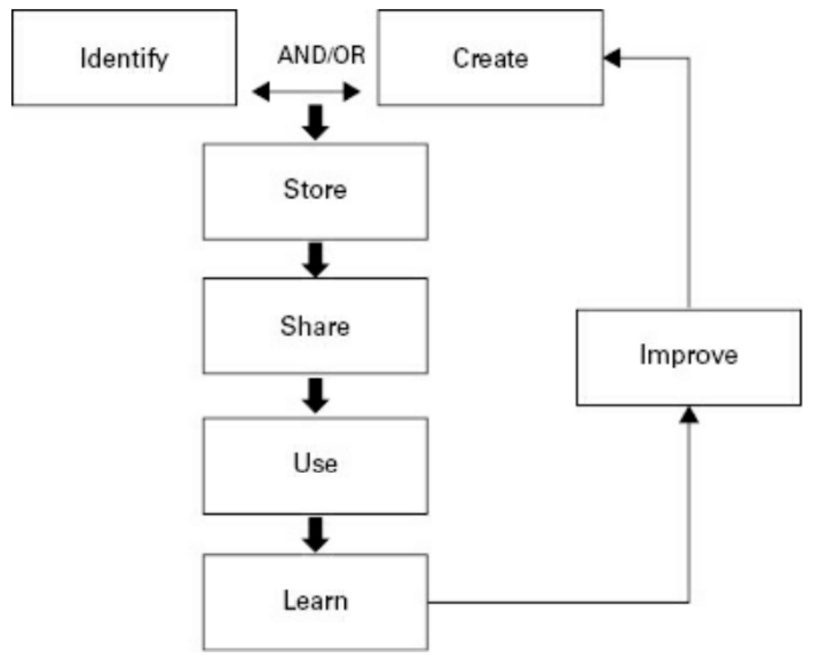
The Evans, Dalkir, and Bidian KM Cycle (KMC)

Slide 38
The Evans, Dalkir, and Bidian KM Cycle (KMC)
Identify: to determine whether the knowledge exists or needs to be created.
Store: the knowledge should be stored in some type of organizational system
Share: the knowledge should be shared both within the organization and, as appropriate, outside the organization (e.g., throughout a professional network).

Slide 39
The Evans, Dalkir, and Bidian KM Cycle (KMC)
Use: the knowledge can be used to solve problems, make decisions, improve on products and services, innovate, and so on.
Learn: is often overlooked. Single-loop learning refers to incremental improvements while double-loop learning is a much more holistic review of the knowledge, which serves not just to improve but recast the knowledge.
Improve: serve to document metadata, to update, refine and, as needed, correct existing knowledge, add to it, and extend the knowledge.

Slide 40
An Integrated KM Cycle
A synthesis of the preceding steps from the six approaches to a KM cycle, these approaches had in common.
The combined steps have been placed in a logical chronological order. The additional steps contributed by each of the four approaches were then added to this table, providing a comprehensive overview of knowledge processing throughout the organizational lifecycle of knowledge.
However, it is important to note that while the cycle is presented as a sequential progression of steps, knowledge management processes typically occur in parallel.

Slide 41
An Integrated KM Cycle
A synthesis of the preceding steps from the six approaches to a KM cycle, these approaches had in common.
The combined steps have been placed in a logical chronological order. The additional steps contributed by each of the four approaches were then added to this table, providing a comprehensive overview of knowledge processing throughout the organizational lifecycle of knowledge.
However, it is important to note that while the cycle is presented as a sequential progression of steps, knowledge management processes typically occur in parallel.

Slide 42
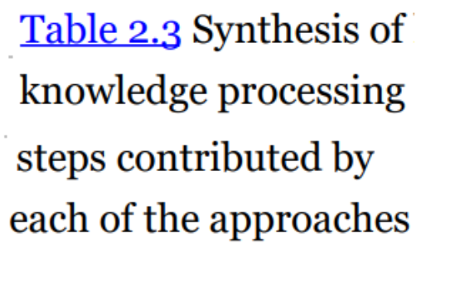
An Integrated KM Cycle
Steps in Common | Step added by
1. Knowledge capture | Evans et al
2. Knowledge creation | Evans et al
2a. Knowledge contribution | Bukowitz and Williams
2b. Knowledge filtering and selection | Bukowitz and Williams
3. Knowledge codification
3a. Knowledge refinement | Meyer and Zack; Bukowitz and Williams; Carlile and Rebentisch
4. Knowledge sharing
5. Knowledge access
5a. Knowledge learning | Bukowitz and Williams; Evans et al
6. Knowledge application | McElroy; Bukowitz and Williams
6a. Knowledge evaluation
7. Knowledge reuse
7a. Knowledge reuse or divestment | Bukowitz and Williams

Slide 43
An Integrated KM Cycle
1. Knowledge capture/creation/contribution
2. Knowledge filtering/selection
3. Knowledge codification
4. Knowledge refinement
5. Knowledge sharing
6. Knowledge access
7. Knowledge learning
8. Knowledge application
9. Knowledge evaluation
10. Knowledge reuse/divestment
1. Knowledge capture and/or creation
2. Knowledge sharing and dissemination
3. Knowledge acquisition and application
The integrated cycle

Slide 44
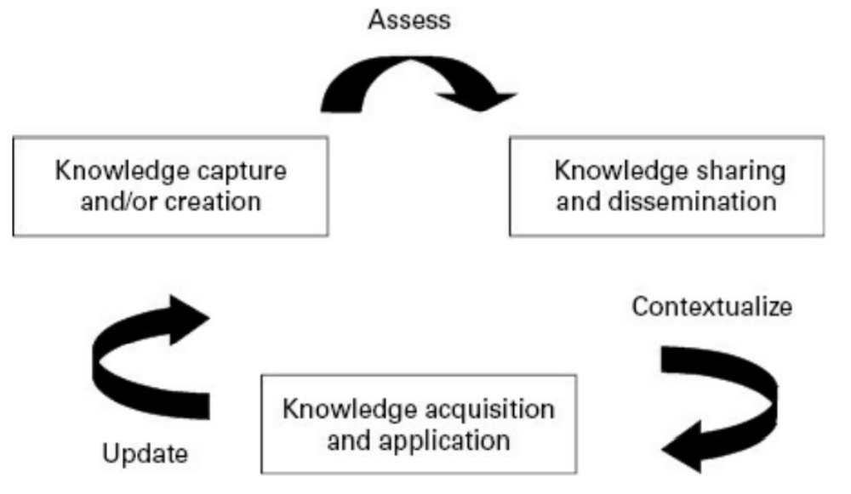
An Integrated KM Cycle

Slide 45
Strategic Implications of the KM Cycle
Knowledge represents the decisive basis for intelligent, competent behavior at the individual, group, and the organization.
Only a conscious and organized reflection of lessons learned and best practices discovered will allow companies to leverage their hard-won knowledge assets.

Slide 46
Strategic Implications of the KM Cycle
Understanding the different stages of managing knowledge throughout the KM cycle is important from a practical perspective:
  Managing knowledge requires organizing principles (framework) that helps classify the different types of activities and functions need to deal with all knowledge-related work within and between organizations

Slide 47
Practical Considerations for Managing Knowledge
Understand the different stages of managing knowledge throughout the KM cycle. From a practical perspective, in order to manage knowledge it is also necessary to have an organizing principle - a framework - to classify the different types of activities and functions needed to deal with all knowledge-related work within and between organizations.

Slide 48
Summary
The way to valuable individual, group, and organizational knowledge.
Compare and contrast major KM processes.
Define the major KM processes and examples of each.
Identify the major challenges and benefits of each KM process.
Describe the additional challenges posed by global or distributed KM processes.

Slide 49

Discussion / Homework / Team Activities
Discuss the different KM cycles approaches and how they may be integrated into a comprehensive, integrated approach to the effective management of knowledge within an organization.
Provide an example of how each of the major KM cycle stages listed below can add value to knowledge and increase the strategic worth of the knowledge asset:
  Capture
  Codify
  Create
  Share
  Acquire
  Apply
Where are the go/no decisions in KM processes? What types of information would you require in order to decide whether or not the knowledge content would continue on to the next step of the cycle?
will be asked again before going through new content

